Slide 1
Computer Networks
Adrian Sergiu DARABANT
Lecture 2

Slide 2
Little Endian/Big endian
In memory data representation
  Big endian – most significant byte first
  Little endian – least significant byte first
46F4 – Little end. => F4 46
- Big end. => 46 F4

Slide 3
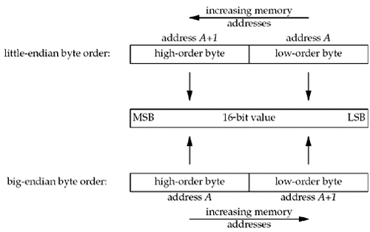
Little Endian/Big endian

Slide 4
Advanced TCP – I/O Modes
Blocking I/O
Nonblocking I/O
I/O multiplexing (select and poll)
Signal driven I/O (SIGIO)
Asynchronous I/O (the POSIX aio_functions)

Slide 5
Network operation steps
Waiting for the data to be ready – i.e. data arrives from the network
Copying the data from the kernel to the process – i.e. copying the data from the kernel buffer into the application space.

Slide 6
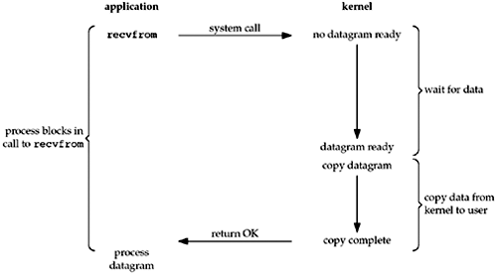
Blocking I/O Model

Slide 7
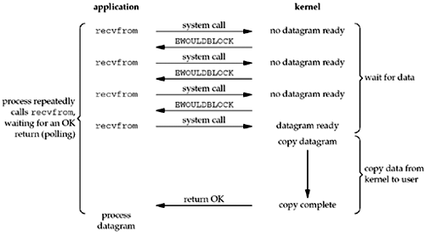
Non-Blocking I/O Model

Slide 8
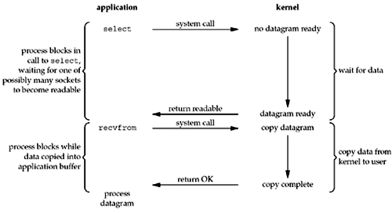
Multiplexed I/O Model
Involves using select and poll

Slide 9
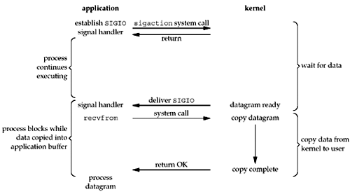
Signal I/O Model

Slide 10
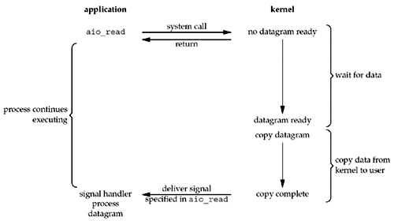
Asynchronous I/O Model
aio_read – asynchronous POSIX read
Async - Kernel tells us when the operation is complete
Signal – Kernel tells us when the operation can start !!

Slide 11
The select system call
#include <sys/select.h>
#include <sys/time.h>
int select(int maxfd+1, fd_set *readset, fd_set *writeset, fd_set *exceptset,
const struct timeval *timeout);
Returns:
  positive count of ready descriptors
  0 if timeout
  -1 on error
void FD_ZERO(fd_set *fdset); - clear all bits in fdset
void FD_SET(int fd, fd_set *fdset); - turn on the bit for fd in fdset
void FD_CLR(int fd, fd_set *fdset); - turn off the bit for fd in fdset
int FD_ISSET(int fd, fd_set *fdset); - IS the fd ready ?
BE WARNED – select modifies readset, writeset and exceptset

Slide 12
Client-Server TCP/IP Apps
Server listens for client’s requests, executes them and answers.
Server types (from the Comm Point of View)
  Iterative Servers (blocking)
  Concurrent servers (fork, threads)
  Concurrent multiplexed servers. (select)

Slide 13
Conditions for a socket to be ready
Condition | Readable | Writable | Exception
Data to read Read half connection closed New connection (for listen) | Y Y Y
Space available for writing Write half connection closed |  | Y Y
Pending error | Y | Y
TCP- out-of-bound DATA |  |  | Y

Slide 14
MultiClient Chat Server -1
#include <stdio.h>
#include <stdlib.h>
#include <string.h>
#include <unistd.h>
#include <sys/types.h>
#include <sys/socket.h>
#include <netinet/in.h>
#include <arpa/inet.h>
fd_set master; // master file descriptor list
fd_set read_fds; // temp file descriptor list for select()
struct sockaddr_in myaddr; // server address
struct sockaddr_in remoteaddr;
int fdmax; // maximum file desc. number
int listener; // listening socket descriptor
int newfd; // newly accept()ed socket
char buf[256], tmpbuf[256];
int nbytes, ret;
int yes=1; // setsockopt() SO_REUSEADDR
int addrlen;
int i, j, crt, int_port,client_count=0;

Slide 15
MultiClient Chat Server -2
struct sockaddr_in getSocketName(int s, bool local_or_remote) {
struct sockaddr_in addr;
int addrlen = sizeof(addr);
int ret;
memset(&addr, 0, sizeof(addr));
ret = (local_or_remote==true?getsockname(s,(struct sockaddr *)&addr, (socklen_t*)&addrlen):
getpeername(s,(struct sockaddr *)&addr, (socklen_t*)&addrlen) );
if (ret < 0)
perror("getsock(peer)name");
return addr;
}

Slide 16
MultiClient Chat Server -3
char * getIPAddress(int s, bool local_or_remote) {
struct sockaddr_in addr;
addr = getSocketName(s, local_or_remote);
return inet_ntoa(addr.sin_addr);
}
int getPort(int s, bool local_or_remote) {
struct sockaddr_in addr;
addr = getSocketName(s, local_or_remote);
return addr.sin_port;
}

Slide 17
MultiClient Chat Server -4
// send to everyone
void sendToALL(char * buf, int nbytes) {
int j, ret;
for(j = 0; j <= fdmax; j++) {
if (FD_ISSET(j, &master))
// except the listener and ourselves
if (j != listener && j != crt)
if ( send(j, buf, nbytes, 0) == -1)
perror("send");
}
return;
}

Slide 18
MultiClient Chat Server -5
int main(int argc, char **argv) {
if (argc < 2 ) {
printf("Usage:\n%s <portno>\n",argv[0]);
exit(1);
}
int_port = atoi(argv[1]);
FD_ZERO(&master); // clear the master and temp sets
FD_ZERO(&read_fds);
// get the listener
if ((listener = socket(AF_INET, SOCK_STREAM, 0)) == -1) {
perror("socket");
exit(1);
}
// get rid of the "address already in use" error message
if (setsockopt(listener, SOL_SOCKET, SO_REUSEADDR, &yes, sizeof(int) ) == -1) {
perror("setsockopt:");
exit(1);
}

Slide 19
MultiClient Chat Server -6
// bind
memset(&myaddr, 0, sizeof(myaddr));
myaddr.sin_family = AF_INET;
myaddr.sin_addr.s_addr = INADDR_ANY;
myaddr.sin_port = htons(int_port);
if (bind(listener, (struct sockaddr *)&myaddr, sizeof(myaddr)) == -1) {
perror("bind:");
exit(1);
}
// listen
if (listen(listener, 10) == -1) {
perror("listen");
exit(1);
}
// add the listener to the master set
FD_SET(listener, &master);
// keep track of the biggest file descriptor
fdmax = listener; // so far, it's this one

Slide 20
MultiClient Chat Server -7
// main loop
for(;;) {
read_fds = master; // copy it – select
if (select(fdmax+1, &read_fds, NULL, NULL, NULL) == -1) {
perror("select");
exit(1);
}
// run through the existing connections looking for data to read
for(i = 0; i <= fdmax; i++) {
if (FD_ISSET(i, &read_fds)) { // we got one!!
crt = i;
if (i == listener) {
// handle new connections
addrlen = sizeof(remoteaddr);
if ((newfd = accept(listener, (struct sockaddr *)&remoteaddr,(socklen_t*)& addrlen)) == -1) {
perror("accept");
}

Slide 21
MultiClient Chat Server -8
else {
FD_SET(newfd, &master); // add to master set
if (newfd > fdmax) { // keep track of the maximum
fdmax = newfd;
}
printf("selectserver: new connection from %s on socket %d\n",
getIPAddress(newfd, false),newfd);
client_count++;
sprintf(buf,"Hi-you are client :[%d] (%s:%d) connected to server %s\nThere
are %d clients connected\n", newfd, getIPAddress(newfd,false), getPort(newfd, false),
getIPAddress(listener, true), client_count);
send(newfd,buf,strlen(buf)+1,0);
}
}

Slide 22
MultiClient Chat Server -9
else {
// handle data from a client
if ((nbytes = recv(i, buf, sizeof(buf), 0)) <= 0) {
// got error or connection closed by client
if (nbytes == 0) {
// connection closed
printf("<selectserver>: client %d forcibly hung up\n", i);
}
else perror("recv");
client_count--;
close(i); // bye!
FD_CLR(i, &master); // remove from master set
}
else {
// we got some data from a client - check for connection close request
buf[nbytes]=0;
if ( (strncasecmp("QUIT\n",buf,4) == 0)) {
sprintf(buf,"Request granted [%d] - %s. Disconnecting...\n",i,getIPAddress(i,false));

Slide 23
MultiClient Chat Server -10
send(i,buf, strlen(buf)+1,0);
nbytes = sprintf(tmpbuf,"<%s - [%d]> disconnected\n",getIPAddress(i,false), i);
sendToALL(tmpbuf,nbytes);
client_count--;
close(i);
FD_CLR(i,&master);
}
else {
nbytes = sprintf(tmpbuf, "<%s - [%d]> %s",getIPAddress(crt, false),crt, buf);
sendToALL(tmpbuf, nbytes);
}
}
}
}
}
}
return 0;
}

Slide 24
MultiClient Chat Client -1
….//include stuff
…..
fd_set read_fds,master; // temp file descriptor list for select()
int sock; //socket
struct sockaddr_in servaddr;
char buf[256]; // buffer for client data
int nbytes, ret, int_port;
int main(int argc, char **argv)
{
if (argc < 3 ) {
printf("Usage:\n%s <hostname or IP address> <portno>\n",argv[0]);
exit(1);
}

Slide 25
MultiClient Chat Client -2
int_port = atoi(argv[2]);
int ipaddr = inet_addr(argv[1]);
// check if address is a hostname
if (ipaddr == -1 ) {
  struct in_addr inaddr;
  struct hostent * host = gethostbyname( argv[1] );
  if (host == NULL ) {
    printf("Error getting the host address\n");
    exit(1);
  }
  memcpy(&inaddr.s_addr, host->h_addr_list[0],sizeof(inaddr));
  printf("Connecting to %s ...\n",inet_ntoa( inaddr) );
  memcpy(&ipaddr, host->h_addr_list[0],sizeof(unsigned long int)) ;
}
// create the socket
if ((sock = socket(AF_INET, SOCK_STREAM, 0)) == -1) {
perror("socket");
exit(1);
}

Slide 26
MultiClient Chat Client -3
memset(&servaddr,0, sizeof(servaddr));
servaddr.sin_family = AF_INET;
servaddr.sin_addr.s_addr = ipaddr;
servaddr.sin_port = htons( int_port );
// connect to server
if (connect(sock, (struct sockaddr *)&servaddr, sizeof(servaddr)) < 0 ) {
perror("connect");
exit(1);
}
// add the socket to the master set
FD_ZERO(&read_fds); // clear the set
FD_ZERO(&master);
FD_SET(0, &master); FD_SET(sock, &master);
while(1) {
read_fds = master;
if (select(sock+1, &read_fds, NULL, NULL, NULL) == -1) {
perror("select");
exit(1);
}

Slide 27
MultiClient Chat Client -4
if ( FD_ISSET(0, &read_fds) ) { // check if read from keyboard
nbytes = read(0, buf,sizeof(buf)-1);
ret = send(sock, buf, nbytes,0);
if (ret <= 0 ){
perror("send");
exit(1);
}
}
if ( FD_ISSET(sock, &read_fds) ) { // check if read from server
nbytes = read(sock, buf, sizeof(buf)-1);
if (nbytes <= 0) {
printf("Server has closed connection... closing...\n");
exit(2);
}
write(1,buf, nbytes);
}
}
return 0;
}

Slide 28
UDP
Connection-Less – datagram oriented
  Recvfrom
  Sendto
No guarantee for datagram delivery
No guarantee for datagram ordering
Type = SOCK_DGRAM – when creating socket

Slide 29
TCP
Connection-Oriented
  Recv
  Send
Guaranteed data delivery
Guaranteed data ordering delivery
Type = SOCK_STREAM – when creating socket

Slide 30
Protocol
Agreement about communication
Specifies
  Format of the messages
  Meaning of the messages
  Rules of exchange
  Procedures for handling problems (errors)

Slide 31
Need for protocols
Hardware is low-level
Problems that can occur
  Bits corrupted or destroyed
  Entire packet lost
  Packet is duplicated
  Packets delivered out of order
  Flow control

Slide 32
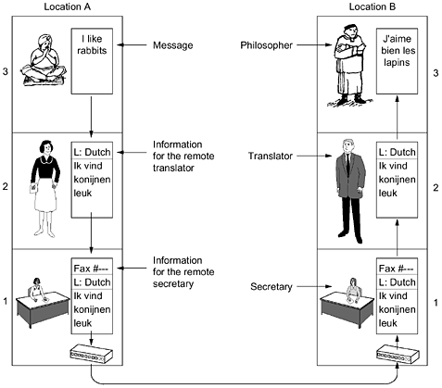
Exemple of layered communication

Slide 33
Protocol Hierarchies
Networks organised as stacks of layers
  Reduce complexity
  Each layer offers services to higher layers
Equivalent to data abstraction
Network architecture = a set of layers and procotols

Slide 34
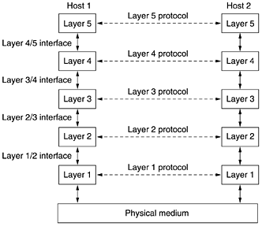
Layers, protocols, interfaces

Slide 35

The OSI Reference Model

Slide 36
Principles of the OSI model
A layer should be created where a different abstraction is needed.
Each layer should perform a well-defined function.
The function of each layer should be chosen with an eye toward defining internationally standardized protocols.
The layer boundaries should be chosen to minimize the information flow across the interfaces.
The number of layers should be large enough that distinct functions need not be thrown together in the same layer out of necessity and small enough that the architecture does not become unwieldy.

Slide 37
The Physical Layer
Raw bits over a communication channel
Data representation
  1–how many volts ?; 0 – how many volts ?
1 bit – How many nanoseconds ?
Bidirectional simultaneous transmission?
Electrical, mechanical, timing interfaces

Slide 38
Data Link layer
Turn the raw transmission into an error free communication line
Sets data in frames=thousands of bytes
Traffic regulation (flow control)
Access to the medium in broadcast shared communication lines

Slide 39
The Network Layer
Controls the operation of a subnet
How packets are routed from source to destination
Quality of service – congestion control
Fragmentation and inter-network problems

Slide 40
The Transport Layer
Accept data from upper layers and splits it into packets (small units)
Ensure that packets arrive correctly to the other end
Type of service: error free PtoP, preserve order or not, guarantees delivery or not, broadcast
True end-to-end layer

Slide 41
The Session Layer
Allows for establishing sessions
Session
  Dialog control
  Token management
  Synchronization

Slide 42
The Presentation Layer
Syntax and semantics of data
Abstract data definitions/ encoding for information exchange between heterogeneous systems
Standard encoding “on the wire”
Exchange unit – record type

Slide 43
The Application Layer
Protocols needed by users:
  HTTP - www
  FTP – file exchange
  TELNET – remote command
  SSH – remote command
  SMTP – mail exchange

